Slide 1
Recruiting
Its’s Easy! Right?
the Key to 20 or more Students in Your District!

Slide 2
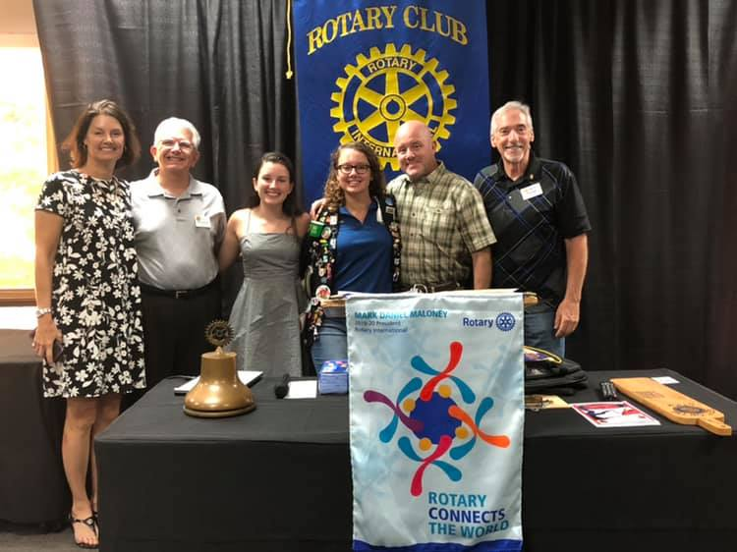
There are three legs to this stool! The First Leg: The Rotary Clubs

Slide 3
Rotary Clubs and RYE
If you have a student at a Rotary club, there has be engagement. Examples of this are:
Monthly meetings by the inbound student
Attendance of the inbound to the fundraising and socials
A strong supportive YEO
Attendance of the Future Outbound while the student is preparing to go on exchange. They need to learn Rotary and The Rotary Club needs to “support this student” from beginning to end.
A strong supportive YEO! One who is keeping the club aware of what their outbound is doing on exchange.
A skype call from the student to the club to connect with them from their country! This has been the Key to success for us! It becomes very real for the club members when they see their student actually in their home or city. They did this! The provided this opportunity! (Psst: This is the first key!)
A presentation to the club when the student returns back to the US.

Slide 4
Rotary Clubs and RYE
What if we need new clubs?
Set a goal of the number of new clubs you want this year.
Target the specific clubs that you feel will be a great asset to the program. Let the clubs know you want be a speaker at the club about RYE and get possible dates
Contact your key Rotex or Rebounds to be a part of the presentation, or better yet, “the presenter!” Then schedule a date that will work for them!
Attend that Rotary Club and let them know:
What RYE is and when it was founded. What is it’s purpose and why it is an important component of Rotary International.
What impact it has made on the students in the program.
What it has meant to host families to gain family around the world and learn about Rotary!
What the cost is to each club and what it covers.
That you need their support! (Our smallest club in 6980 has sponsored 2 students!)
Get a contract signed with a commitment for the next year!

Slide 5
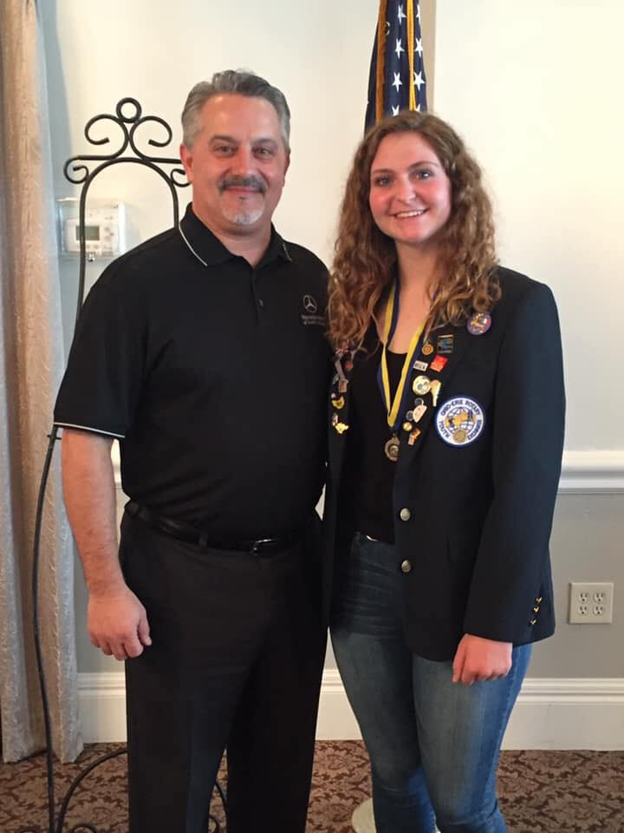
“We could not be more proud of Aubrey. What she has done with our club, Interact and the community. She is going to be a great representative of Rotary and our club! She deserves this Paul Harris!” -Walter Grundorf President Lake Mary Club

Slide 6
The second leg to the stool Schools!
Recruiting in the schools starts in July!
Identify the number of schools you would like to speak to about Rotary Youth Exchange!
Identify the schools that would be open to having a presentation.
Is there a Principal that is a Rotarian?
Is there a high school that is supported by a Rotary Club?
Is there is a teacher that would allow you to come and speak to their class?
Is there a Rotarian that is on the School Board!!
Is there a parent at the school who knows the principal?
Schedule a meeting with the Principal, teachers or Rotarian to discuss the options of presenting the program to their students.

Slide 7
Speaking Points for meeting with School Personnel
What is Rotary Youth Exchange and why do we volunteer do this program?
what does it offer to the American students attending high school?
A culture experience for sure, but so much more! Language proficiency, life skills, adaptability and a killer college application!
It is considered a scholarship since so much is provided by Rotary
An experience that will not only touch the student but their friends and family as well.
It is the “program” we all wish we had as a high school student. We just need to get the information out to the students and parent.
Present a flyer that will be given to the students during the presentation with the information sessions set up and solid information about the program.
What parents are saying about their child's experience on exchange!
Can I present to your teachers first? Can you come see the presentation at another school?
If there is a school you are presenting to, can you give that principal as a contact for a new school?

Slide 8
So you got a stage? Lets get started!!

Slide 9
Get Prepared!
What Rotex or Rebounds do you have that can assist you in Presentations? The Rebounds and Rotex are very important!
Define a day and location can you have an information session for the parents.
Create a flyer. This is something the students can give to their parents. Make sure important dates are on the flyer (mostly the information sessions), as well as social media sites or websites where more information can be obtained. This gives the program more validity.
Create a Social media account, (Or ask a rebound/rotex to do this). Post pictures of what students are doing now.
Create a presentation that works best for you! Include pictures of the students who are currently out! Highlight what schools they are coming from.

Slide 10
Rotary Youth Exchange Presentation

Slide 12
Notes:
LiveSlide https://prezi.com/embed/vhhvbxxftais/?bgcolor=ffffff&lock_to_path=0&autoplay=0&autohide_ctrls=0&landing_data=bHVZZmNaNDBIWnNjdEVENDRhZDFNZGNIUE43MHdLNWpsdFJLb2ZHanI5eitwOGNhbnNHMjJqZFIrTW9oa2htTGpRPT0&landing_sign=JXpnVYVjCnyrQq2O1YZ0EJL7d-OrTII87Edd0pzauOQ

Slide 13
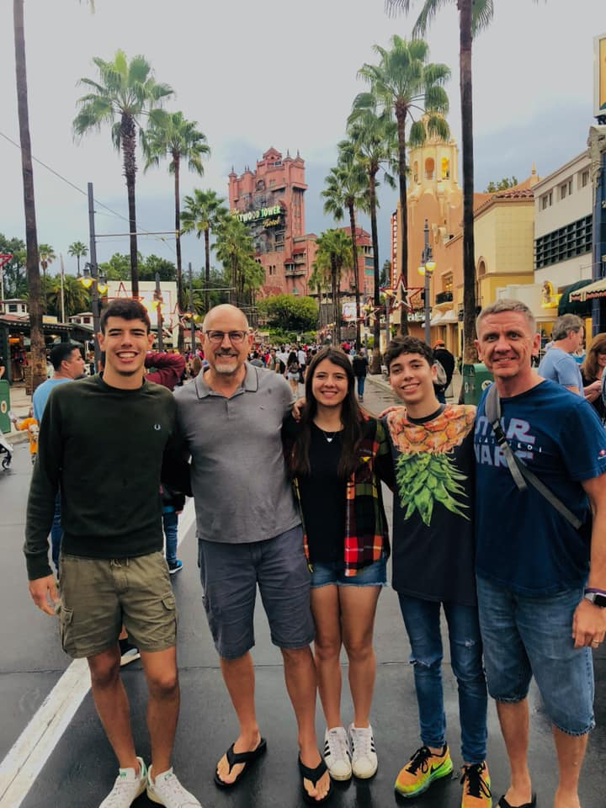
The third leg to the stool! Host Parents
Host Parents in many districts come from Rotary Clubs members, families and friends of RYE Volunteers, however this stream wears thin quickly.
There is nothing special to recruiting new host families. They come when you recruit new students!

Slide 14
Notes:
LiveSlide https://prezi.com/vhhvbxxftais/?utm_campaign=share&utm_medium=copy&rc=ex0share

